Slide 1

Agile Coaching and DevOps Enablement Project Azure Boards Training
Session 2 – Best Practices
06/28/21

Slide 2
Agenda
Overview
Agile Culture & Tools
Scaling DevOps Teams
Work Item Queries
Query Editor & Results
Sharing & Security
Walkthrough: Query Editor
Bulk Editing in Excel
Walkthrough: Excel Integration
Tracking Work Effectively
Feedback & Notifications
Teams Integration
Walkthrough: Notifications
Walkthrough: Delivery Plans

Slide 3

My Background – Saul Dolgin
I have been helping organizations unlock technology value for more than 25 years. Most recently I am focused on cloud infrastructure & DevOps processes with a tilt towards enabling "everything as code." Prior to launching on my consulting journey, I had been a software developer, release manager, enterprise architect, and IT director among other titles. My passion for all things Microsoft Azure have led me to earn 4x certification status with my goal being to never stop learning.
I have been writing code since early childhood, when the first family PC (an IBM PC 286) was brought into the home. I started out by hacking up public domain floppies from a local bookstore and have never looked back since then. I am grateful to have had known from those early days exactly what I wanted to build my career on... helping business do more with software.
Certifications
AZ-400: Azure DevOps Engineer Expert
AZ-500: Azure Security Engineer Associate
AZ-204: Azure Developer Associate
AZ-104: Azure Administrator Associate
Experience – Highlights
Interests
Azure Infrastructure & DevOps Consultant
IT Director, Architecture & Design
Enterprise Architect
Release Manager
Software Developer
My wife & kids
Snorkeling
Beach sand
Cycling / e-bikes
Learning & helping others learn
Skills
Coaching & Training
Team Leadership
Azure DevOps
Agile Methodologies
Software Architecture
Infrastructure as Code
Data Center Migration

Slide 4
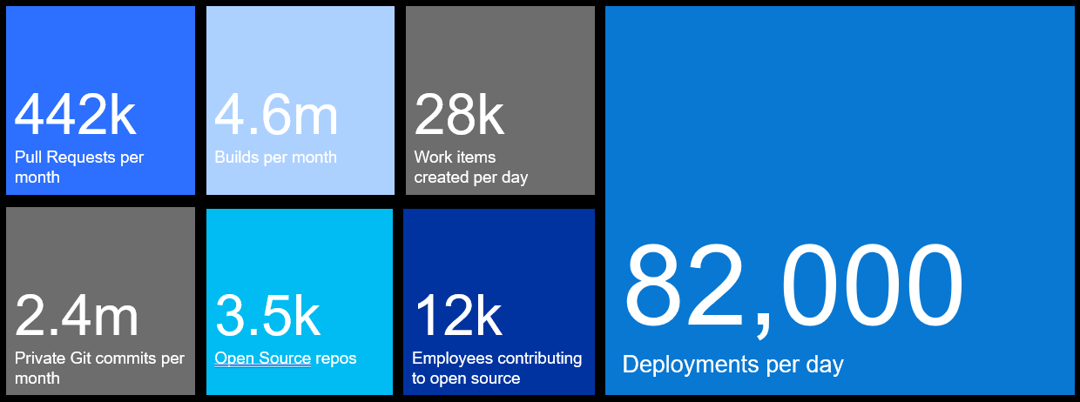
DevOps at Microsoft
Azure DevOps is the toolchain of choice for Microsoft engineering with over 100,000 internal users
➔
https://aka.ms/DevOpsAtMicrosoft
Data: Internal Microsoft engineering system activity, March 2019

Slide 5
Best Practices – Agile Culture
Two obligations to consider…
Creating alignment across the enterprise
Supporting team autonomy
Product Vision
Team Structure
Development Cadence
Communication Cadence
Quality
Manage Risk / Track Work
Setup the tool to address each area above & maximize alignment balanced with team autonomy

Slide 6
Best Practices – Agile Tools
Preferences vs. Best Practices
Preference: How individuals prefer to use the tool with little difference in meeting our goals.
Best Practice: More than preference, the best way to use a tool for our goals. Preference: Which side of the plate you place cutlery when setting the table for a dinner party. Best Practice: How you hold the knife to cut your food at the dinner party.
Preference: What you decide to call the columns.
Best Practice: Minimizing the number of columns on the Kanban.
Leveraging our combined experience, we’ll give you the best way to use the tools effectively.

Slide 7
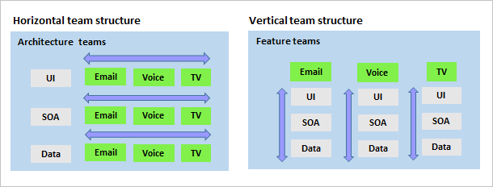
Best Practices – Feature Teams
Vertical teams > Horizontal teams
Define teams along value streams
Provides greater team autonomy
Potentially more efficient*
Setup for greater team autonomy aligned to the value streams for your organization

Slide 8
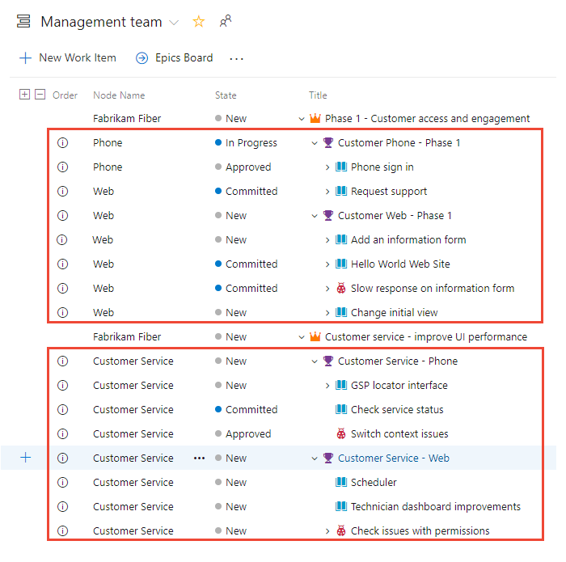
Best Practices – Portfolio Teams
Management backlogs for tracking across all teams
Portfolio backlogs tie all value streams together
Disable product level backlog for Portfolio team
Avoid creating “silo” Epics for feature teams
Add Node Name column for cross-team tracking
Well-defined epics & initiatives help to make work visible across all value streams

Slide 9
Azure DevOps – Staying Informed
Sources for more information…
Feature Timeline & Release Notes – High-level Roadmap of features released or planned
Azure Boards Documentation – Evergreen articles, concepts & reference docs
Documentation Updates – Monthly journal of all new & updated documentation articles
Community Feedback – Search for and request new features for DevOps
DevOps Resource Center – Learn about how Microsoft works with DevOps
Channel 9 Video Content – Search for “DevOps” or “Azure Boards”
If all else fails, reach out to a DevOps Team Administrator or a member of the MBG project team(s)!

Slide 10
Effective Work Item Queries
Writing effective queries requires understanding of the following aspects:
Macro Tokens – create queries relative to a date, area path, iteration, etc.
Query types – Flat list, direct links & tree-topology
Sharing Queries – Access permissions, organizing folders, favorites, etc.
WIQL Playground (for ASOF analysis)
80/20 rule… most of the time you should be using Kanban, Backlog or Taskboard views.

Slide 11
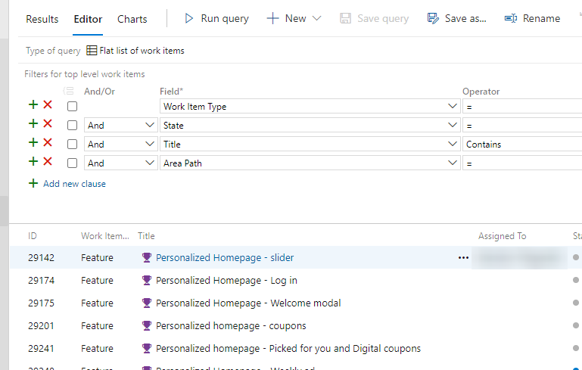
Walkthrough
Work Item Query Editor
Notes:
Review how to navigate to different queries (my vs. shared)
Review query result types & show difference in effect
Review ability to Organize by folder & set permissions on folders to avoid accidents (no undelete)
Show how to import/export WIQL file which is recommended to version control for critical queries
Create a query using @Me & @Today (show macro documentation)
Show items from current iteration that have changed date < @Today – 30 (stale items)
Show items where story points > 8
Show query result with related links of a given type (predecessor / successor)
Query for given tags

Slide 12
Bulk Edit Work Items
Connect Excel to Azure Boards
Support for adding work items, updating existing work items, adding links & attachments, etc.
Native Excel features supported (formula calculations, copy/paste rows, auto-fill, etc.
Add tags in bulk (multiple tags separated by semicolon)
Create Pivot tables, use multiple worksheets and save workbook files for re-use
Work offline, reconnect and publish changes supported
Connecting to Azure DevOps requires Azure DevOps Office Integration 2019 (free download)

Slide 13
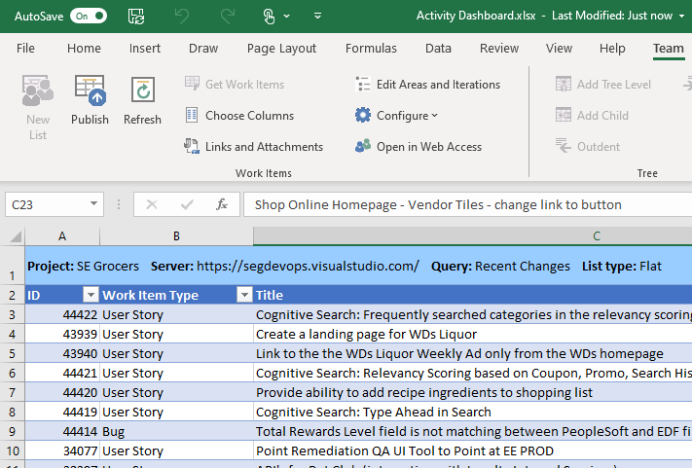
Walkthrough
Work Items in Excel
Notes:
Review software installation
Review the COM add-in setting
Review the Ribbon control
Publish / refresh
Connection / List settings
Add / remove columns
Use this to add multiple work items into the backlog
Save & close the file, update work item in web UI, re-open the file & refresh the data
Build a pivot table based on latest changes

Slide 14
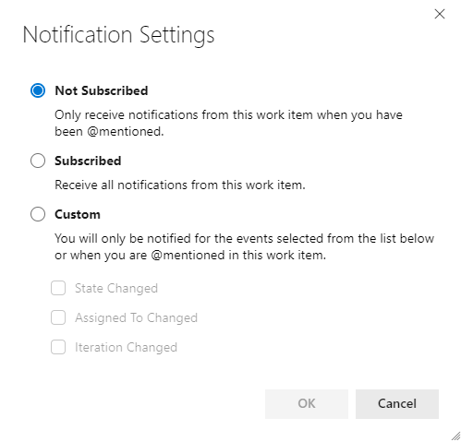
Capturing & Tracking Feedback
Asking for feedback is only half the battle…
@ mention a person in the description or discussion fields
Solicit feedback by emailing work items or query results
Integration with MS Teams channels can help
Make sure you track the feedback as it comes in!
Follow a given work item
Review the “Mentions” work item view
Tag items needing feedback, write a query or filter by tag
@ mentions & the follow feature work best for single work items. Use personal notifications for criteria-based alerts.

Slide 15
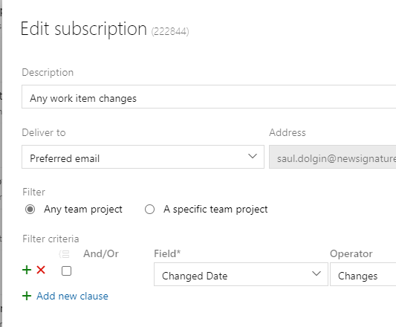
Personal Notifications
Send email just for yourself
Custom notifications based on criteria
Alert on deleted, assigned or changed work
Unsubscribe or opt out of notifications

Slide 16
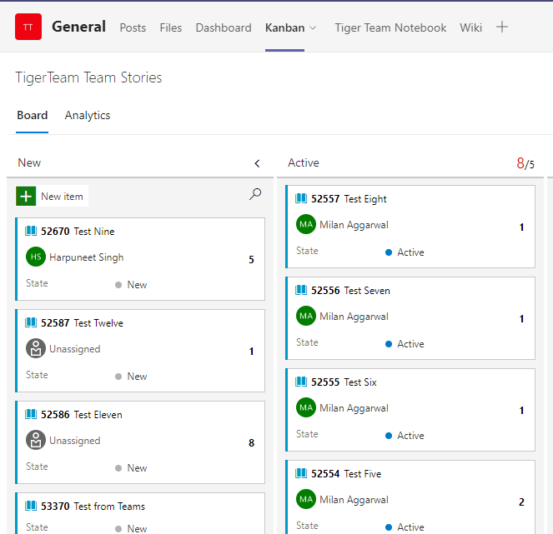
MS Teams Integration
Include as tabs in Teams Channel
Create work items directly from chat
Send message to channel when work changes
Required Teams app for integration
Azure Boards for Microsoft Teams
Requires OAuth 2.0 enabled in DevOps
Authorization using OAuth 2.0

Slide 17
Walkthrough
Feedback & Notifications
Notes:
- Do @Mention in the comments and show how it sends an email
Email backlog to team member
Follow an item, change the details & show it emails about those changes
Build a personal notification for all changes to be emailed to me

Slide 18
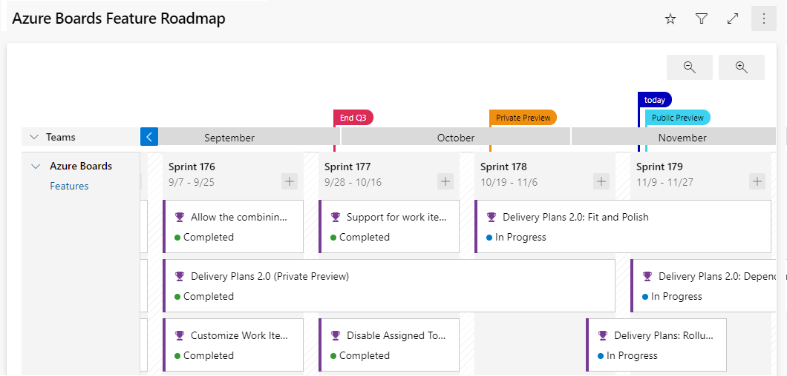
Delivery Plans
Track schedule dependencies across teams
View multiple backlogs across teams spanning several iterations
View dependencies that exist between work items
Adjust start/end dates via drag & drop

Slide 19
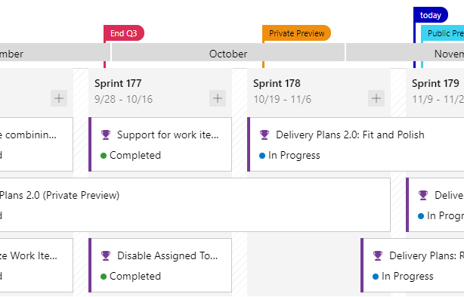
Walkthrough
Create a Delivery Plan
Notes:
Build a delivery plan showing
Multiple teams, multiple backlogs
Add milestones
Show dependency warnings for related work items
Drag & Drop to update iteration paths… watch out for child items not updating

Slide 20

Questions & Answers
This Photo by Unknown Author is licensed under CC BY-SA

